Slide 1

Surgical Video Analysis
AIML Project Elective Term II 2022-23
Week V Apr 12-17

Slide 2
Gradient Paths
The path taken by optimization algorithm during the training process to minimize the loss function of the model.
It refers the sequence of weights computed while computing optimal weights.

Slide 3
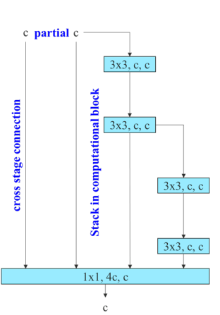
ELAN Architecture
ELAN - Efficient Layer Aggregation Network
By controlling the shortest and longest gradient path, a deeper network can learn and converge effectively.

Slide 4
Expand, Shuffle and Merge Cardinality
Expansion: Increase the cardinality of a block
Shuffle: Rearranging the output channels
Merge: Concatenate the outputs of two blocks

Slide 5
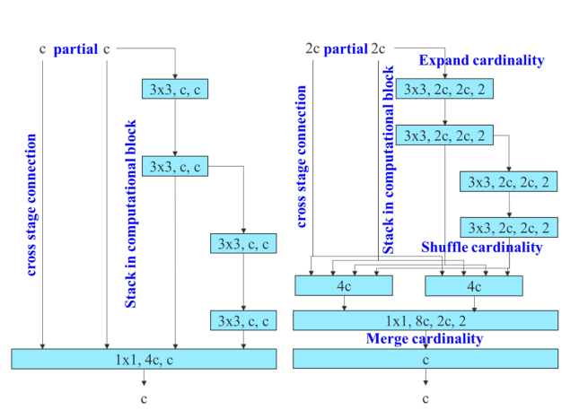
E-ELAN
E-ELAN – Extended ELAN
Uses expand, shuffle and merge cardinality on ELAN
Achieve the ability to continuously enhance the learning ability of the network without destroying the original gradient path.

Slide 6

Trainable bag-of-freebies
BoF: Methods that increase the performance of the model without increasing the training cost.
Methods said in YOLOv7:
Planned Re-parameterization Convolution
Coarse for auxiliary and fine for lead loss

Slide 7
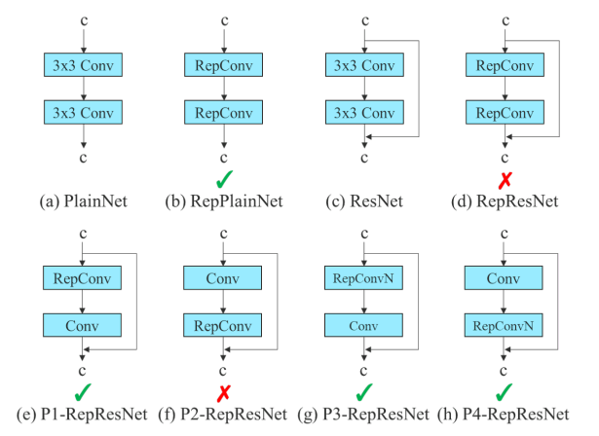
Planned RepConv
RepConv
3x3 convolution layer + 1x1 conv layer + identity connection
After analyzing the combination and corresponding performance of RepConv and different architectures, we find that the identity connection in RepConv destroys the residual in ResNet and the concatenation in DenseNet
Author's thought:
A conv layer replaced with RepConv – no identity connection if conv layer has residual/concatenation

Slide 8

Next week
Implementation started – 50% done – showcase the results of applying YOLOv7 on the given dataset

